Slide 1
Lesson 09: Model Interpretability

Slide 2
Today's Agenda
MACHINE BIAS
Model Interpretability
LIME
Shapley

Slide 3
Machine Bias & Model Interpretability

Slide 4

Criminal Risk Scoring or How not to create Risk Scoring Systems
Why do we need Transparency, Accountability and Fairness in Machine Learning?
One way to achieve these goals is through embedding explanations in Machine Learning
Problems with the Criminal Risk Scoring System should be used as guides for other domains to not make the same mistakes
Arizona, Colorado, Delaware, Kentucky, Louisiana, Oklahoma, Virginia, Washington and Wisconsin use Criminal Risk Scoring systems in the Judicial System in the US

Slide 5
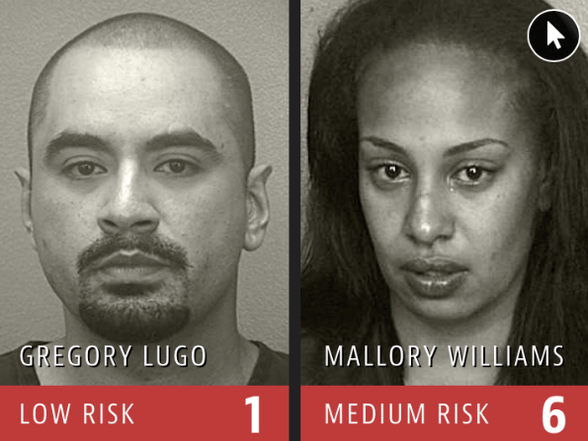
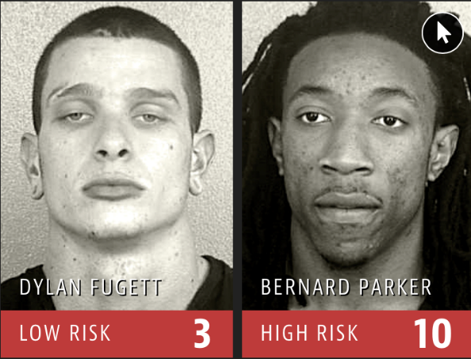
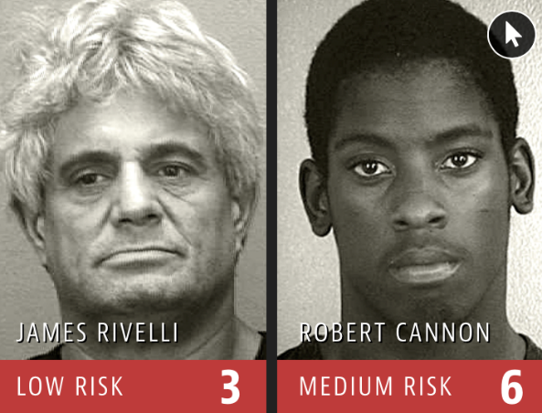

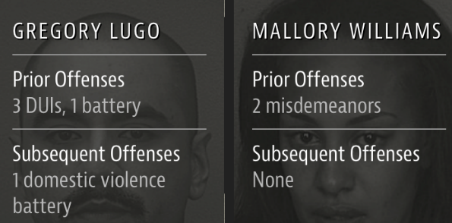
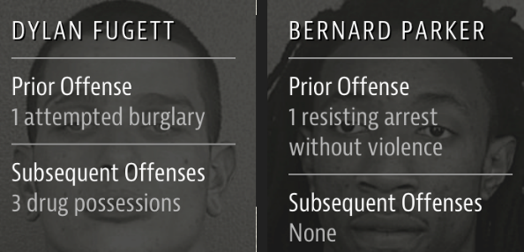
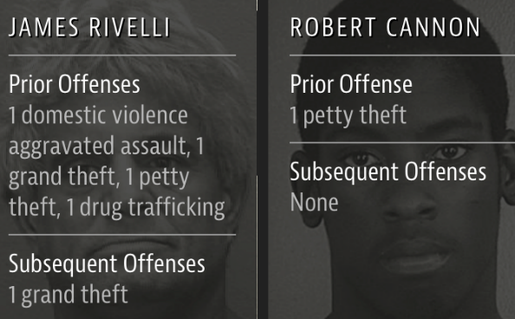

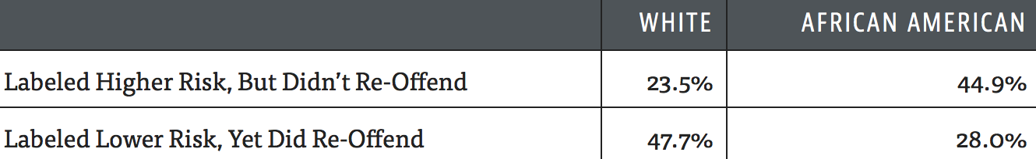
Bias in Criminal Risk Scoring Systems
(Source: ProPublica)

Slide 6
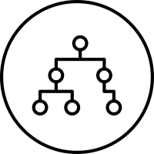
MACHINE BIAS
“Although these measures were crafted with the best of intentions, I am concerned that they inadvertently undermine our efforts to ensure individualized and equal justice, …. they may exacerbate unwarranted and unjust disparities that are already far too common in our criminal justice system and in our society.”
- United States Attorney General, Eric Holder 2014
Criminal Risk Scoring Systems
Northpointe (for-profit company)
Most widely used assessment tools in the country
Risk score calculation is not publically disclosed (proprietary)
Impossible for defendants to argue about bias that may be present in these systems.

Slide 7

ProPublica Study
Obtained risk scores of 7,000 people arrested in Broward County, Florida, in 2013 and 2014
Checked to see how many were charged with new crimes over the next two years (benchmark used by the creators of the algorithm)
The algorithm is better than random
61% of high risk offenders actually re-offended
Misclassification Problems
Falsely labeled black defendants as future criminals twice as many times as white defendants
White defendants were mislabeled as low risk more often than black defendants
https://www.propublica.org/article/machine-bias-risk-assessments-in-criminal-sentencing

Slide 8
LESSONS TO BE LEARNED
Don’t trust Arbitrary Scoring Systems unless they make domain sense
“A guy who has molested a small child every day for a year could still come out as a low risk because he probably has a job, Boessenecker said. Meanwhile, a drunk guy will look high risk because he’s homeless. These risk factors don’t tell you whether the guy ought to go to prison or not; the risk factors tell you more about what the probation conditions ought to be.” ProPublica
Even well-intentioned engineering can lead to adverse social effects
The effects of what we are seeing for Criminal Scoring Systems is not what its creators had intended
Need for open and fair systems in machine learning
Open and fair machine learning is needed in order to give additional information the users of machine learning so that such systems can be audited in case of a wrong assessment or prediction
Need to educate users of ML systems
Educate users of machine learning systems with respect to what the models are predicting vs. what they might think the system is doing (predictive vs. prescriptive vs. descriptive vs. causal models)

Slide 9
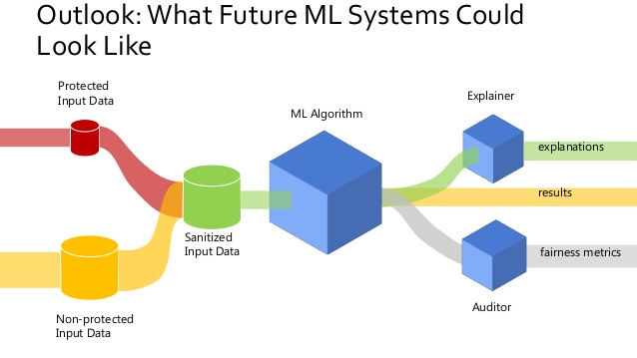
Source: Andreas Dewes

Slide 10
Need for Explanations in Machine Learning
Decision Making:
Why is the machine learning algorithm making a prediction?
What if the reasons for making the prediction are wrong?
Fairness:
Are different populations in the dataset being scored fairly?
Regulation:
GDPR’s right to explanation

Slide 11
Model Interpretability

Slide 12

Problem: Machine Learning is a Black box
Output
(Label, sentence, next word, game position)
?
Black-box AI
Input
(Data, image, sentence, etc.)

Slide 13






Black-box AI creates confusion and doubt
Can I trust our AI decisions?
Business Owner
Why I am getting this decision?
How do I answer this customer complaint?
Customer Support
Black-box AI
How do I monitor and debug this model?
Poor Decision
IT & Operations
How can I get a better decision?
Is this the best model that can be built?
Data Scientists
Are these AI system decisions fair?
Internal Audit, Regulators

Slide 14

Early History
Explanations and interpretability are currently at the cutting edge of ML
Many people assume that this a new topic
The earliest work in AI was rooted in logic to make mechanical reasoning transparent and easily understood
Logic Theorist (1955-56) could prove mathematical theorems given a problem
World’s first programmable Automata 12th century
The Al-Jazari orchestra, one of the earliest examples of known automatons. Credit: Freer Gallery of Art

Slide 15
Why do we need explanations now?
Machine Learning models have shown tremendous success in various prediction tasks
Availability of large amounts of data
Availability of cheap computing power
Ease of data collection
Deployment of ML systems in multiple domains

Slide 16
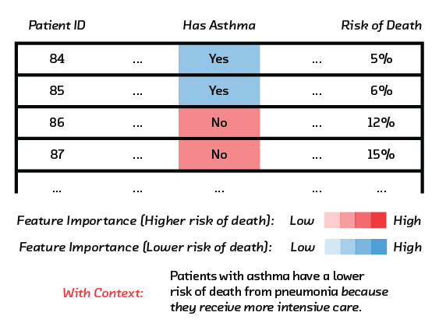
Need for ML Explanations
Case Study of Model with Erroneous Recommendations
Algorithms to predict which pneumonia patients should be admitted to hospitals and which treated as outpatients
Neural nets were far more accurate than classical statistical methods
However, it turned out that both the regression and the neural net had inferred that pneumonia patients with asthma have a lower risk of dying, and shouldn’t be admitted
But the opposite is true. Patients with asthma are high-risk. This was not captured in the data because asthma patients with pneumonia usually were admitted not just to the hospital but directly to the ICU, treated aggressively, and survived.

Slide 17

When is Model Interpretability Needed?
Any context where humans are required to provide explanations so that people cannot hide behind machine learning models
Where the decision based on the model predictions can have far reaching consequences, e.g., recommend an operation
Notes:
the admin responsible for staffing in ED is less likely to care about explanations in ED load prediction models. The exception is when there is rapid and massive change in the demand. In contexts where the premium is in accuracy (or other quantitative metric)

Slide 18
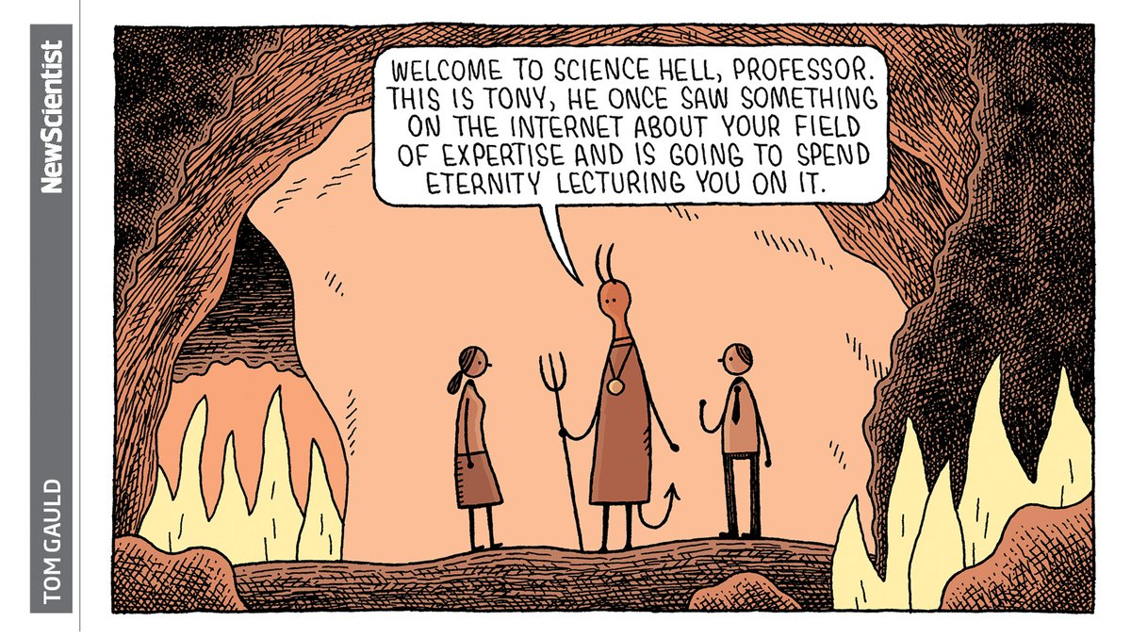
When are explanations not needed?
When are Contexts where Model Interpretability is not needed
Explanation Agnostic contexts, e.g., ED Staffing Prediction
Models which have shown to be highly effective empirically i.e., e.g., 98% accuracy for a diagnosis for the AI system
Systems that have theoretical guarantees on their performance

Slide 19
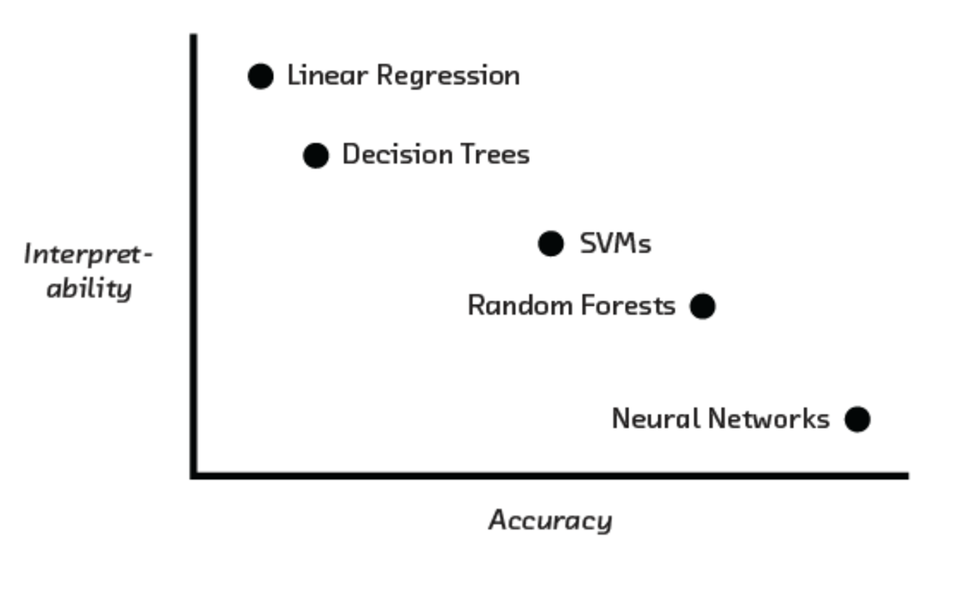

Accuracy vs. Interpretability

Slide 20

The Problem of Generalizability
Adrian Thompson (Sussex University) used neural networks to design circuits that could distinguish between 2 audio tunes
Resulted in a system with near perfect performance and fewer inputs than what humans use
Patterns picked up by the system were not generalizable
The algorithms can’t know which of those patterns exist nowhere else
The ML system was overfitting without realizing it

Slide 21
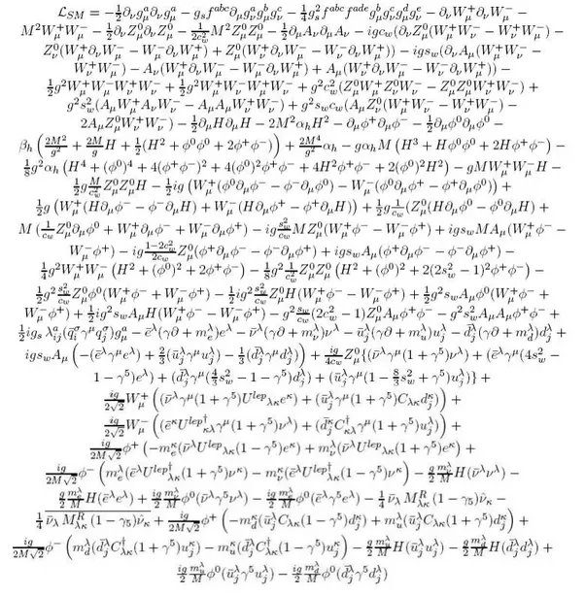
Defining Interpretable Machine Learning
Interpretable machine learning refers to giving explanations of machine learning models to humans with domain knowledge
Explanation: Why is the prediction being made?
Explanation to Human: The explanation should be comprehensible to humans in (i) natural language (ii) easy to understand
Domain Knowledge: The explanation should make sense to a domain expert
Standard Model Lagrangian

Slide 22
Limits of Explanations
“You can ask a human, but, you know, what cognitive psychologists have discovered is that when you ask a human you’re not really getting at the decision process. They make a decision first, and then you ask, and then they generate an explanation and that may not be the true explanation.”
- Peter Norvig

Slide 23
Desiderata for Interpretability in ML
Causality
The model can find causal links between variables and the outcome e.g., smoking and lung cancer. Note: Supervised Learning Algorithms learn associations which may not be causal.
Transferability
The results should generalize from the model building setting to the deployment setting even beyond issues related to overfitting e.g., be resistant to adversarial attacks.
Informativeness
Provide useful information about the model variables and the target
Fair Decision Making
Free from bias

Slide 24
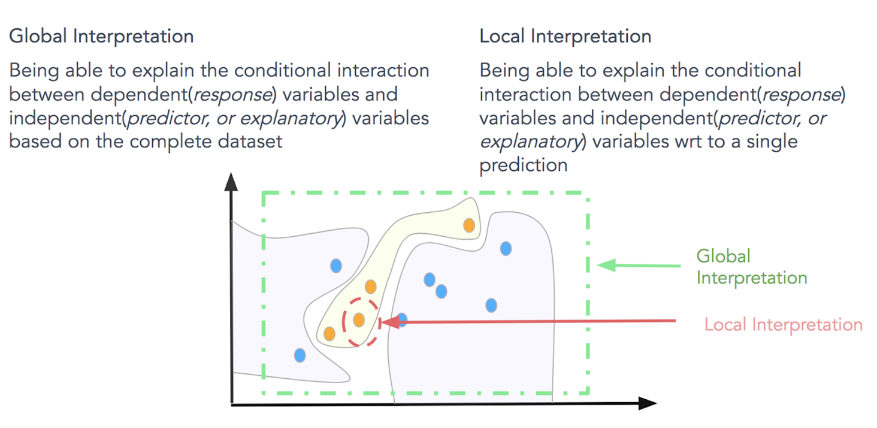

Global vs. Local

Slide 25
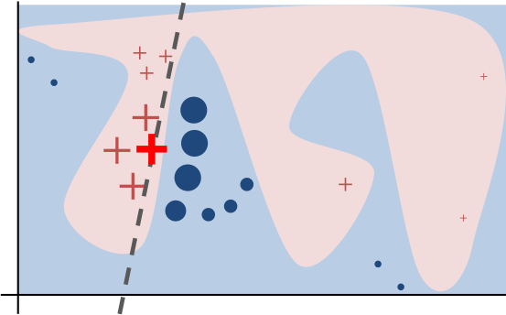
LIME
Locally Interpretable Model-agnostic Explanations
Given a non-interpretable model create local interpretable models that are good approximates of the data at the local level
The local model can be linear models like regression models
LIME simulates the distribution of the data locally
Can be problematic if the decision boundary is not linear locally

Slide 26
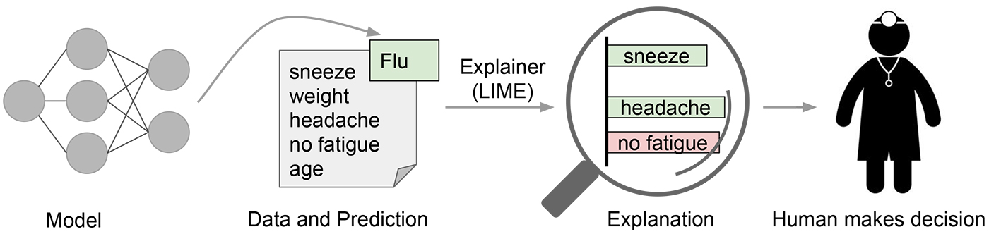
LIME: Model Explanations

Slide 27
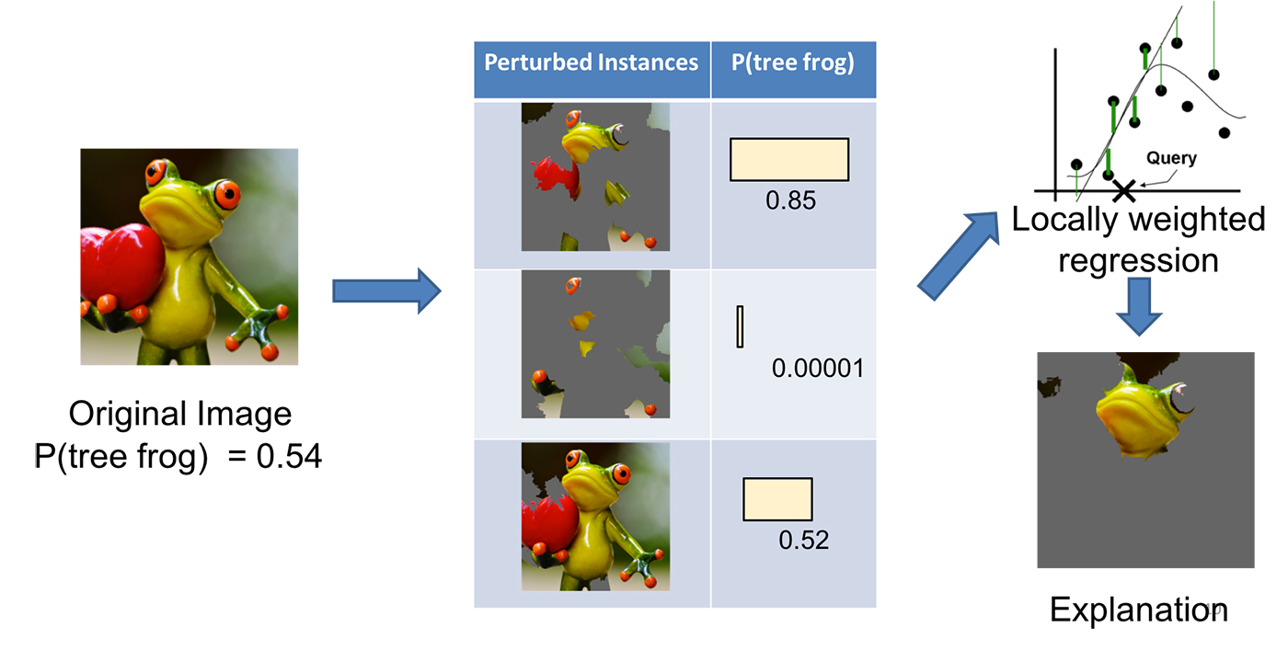
LIME: Explanations

Slide 28
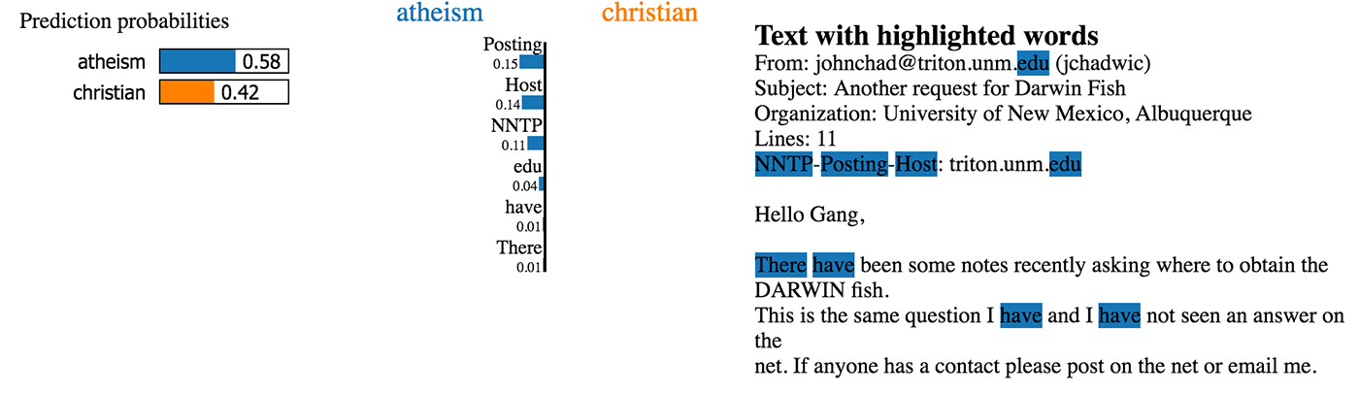
LIME: Explanations
Example of predicting the right label because of an artifact of the data

Slide 29
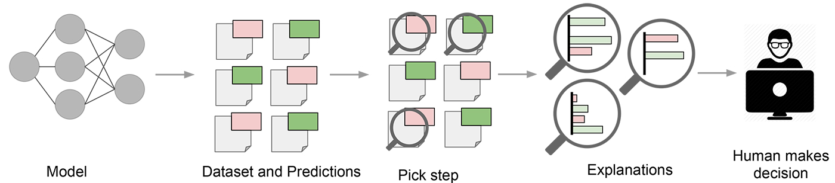
LIME: Explanation Actionability

Slide 30
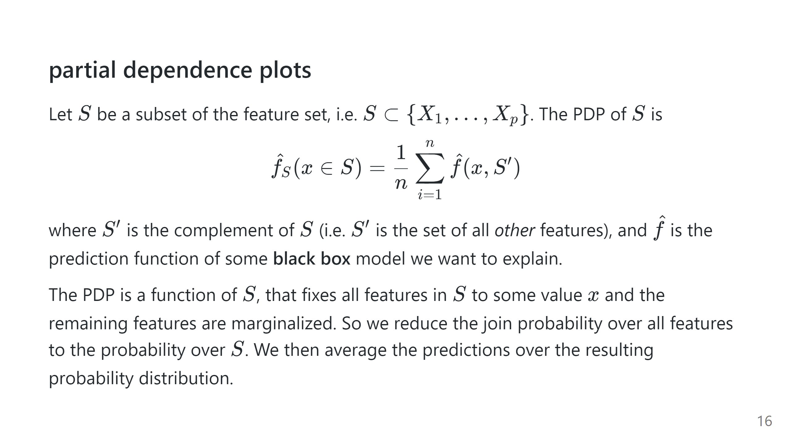

Slide 31
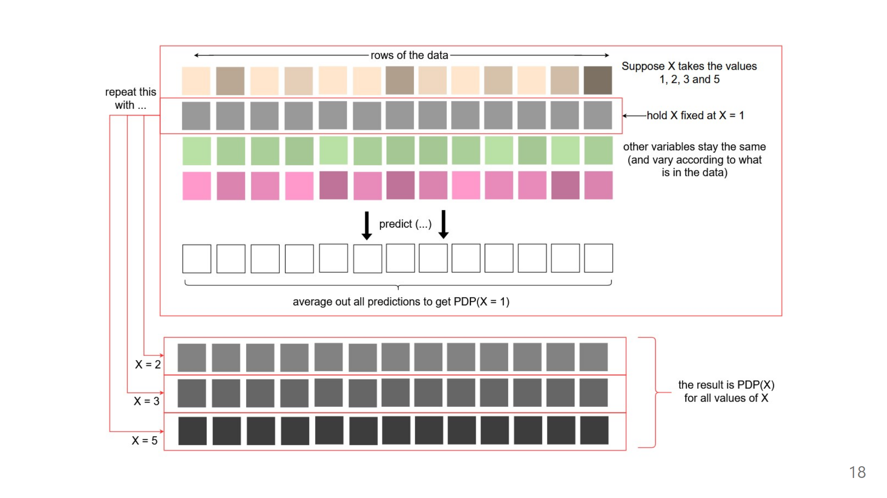

Slide 32
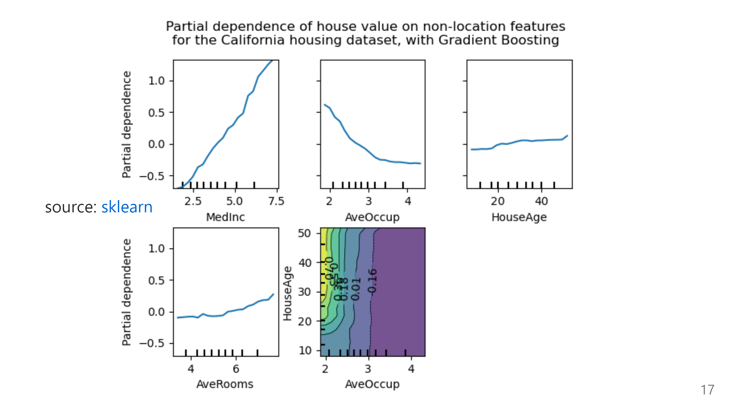

Slide 33
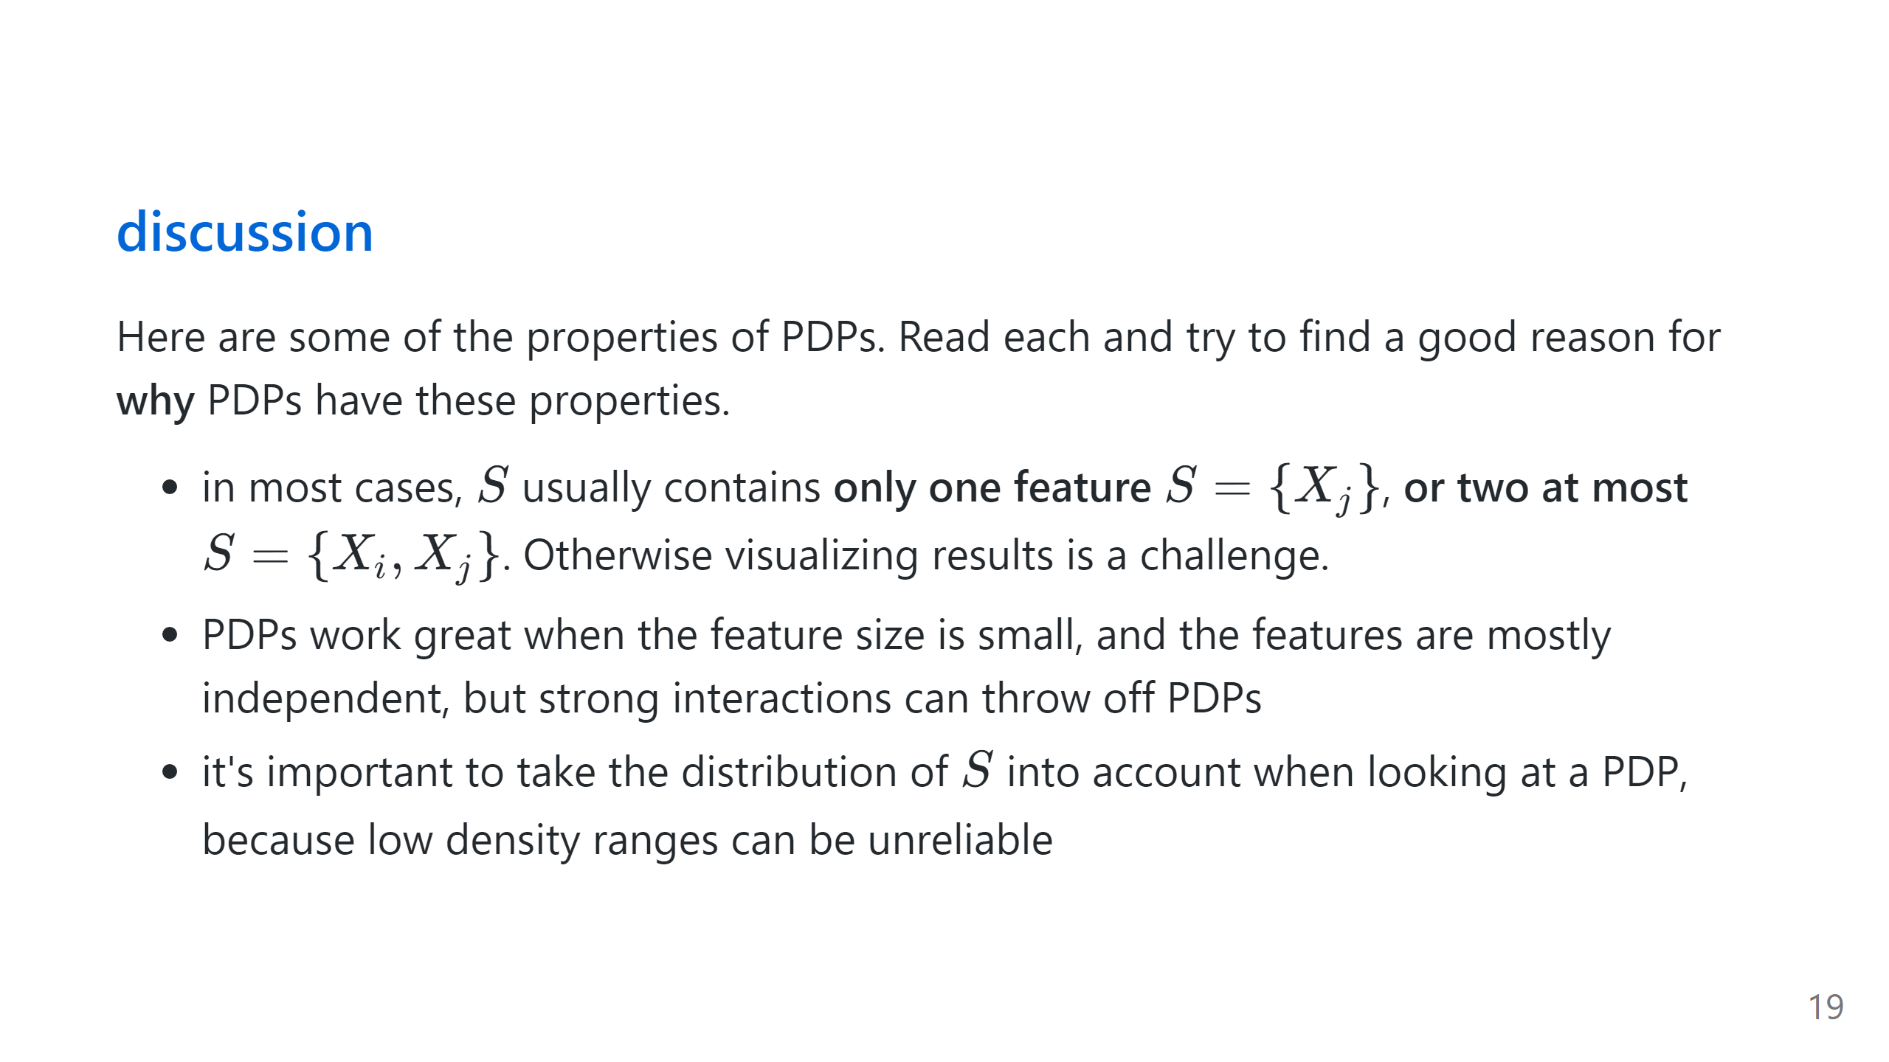

Slide 34
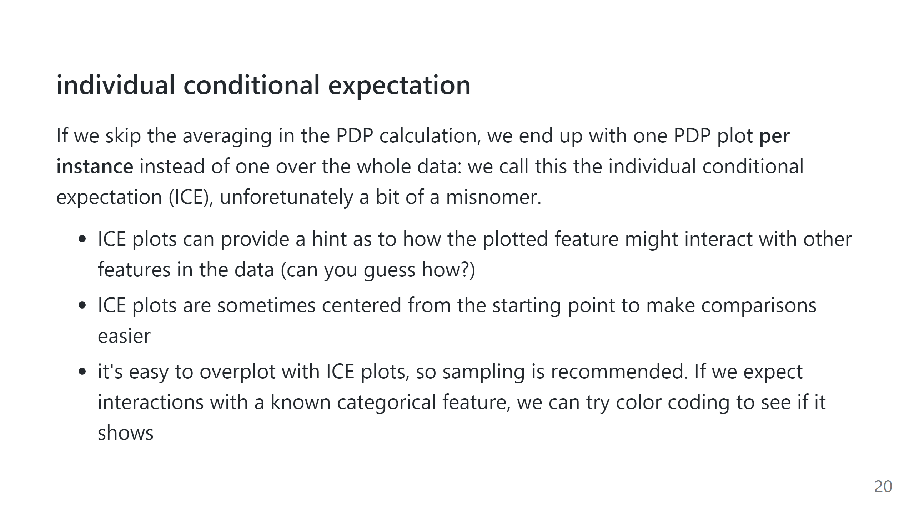

Slide 35
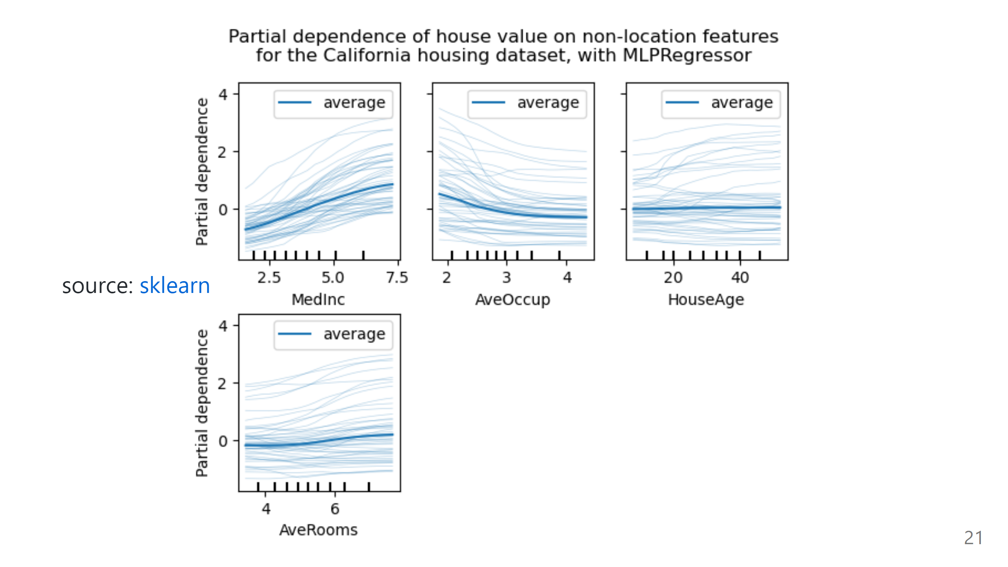

Slide 36
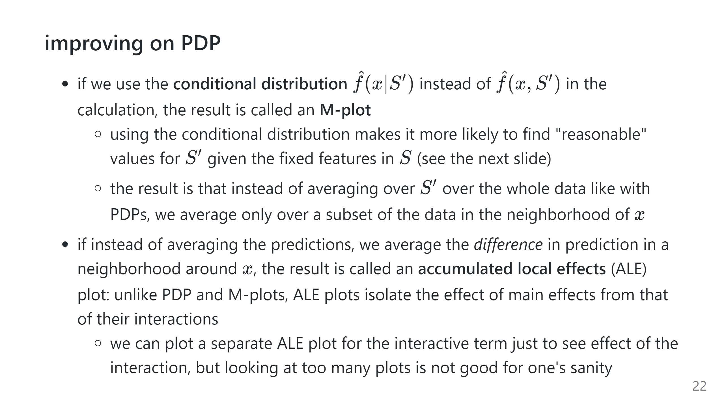

Slide 37
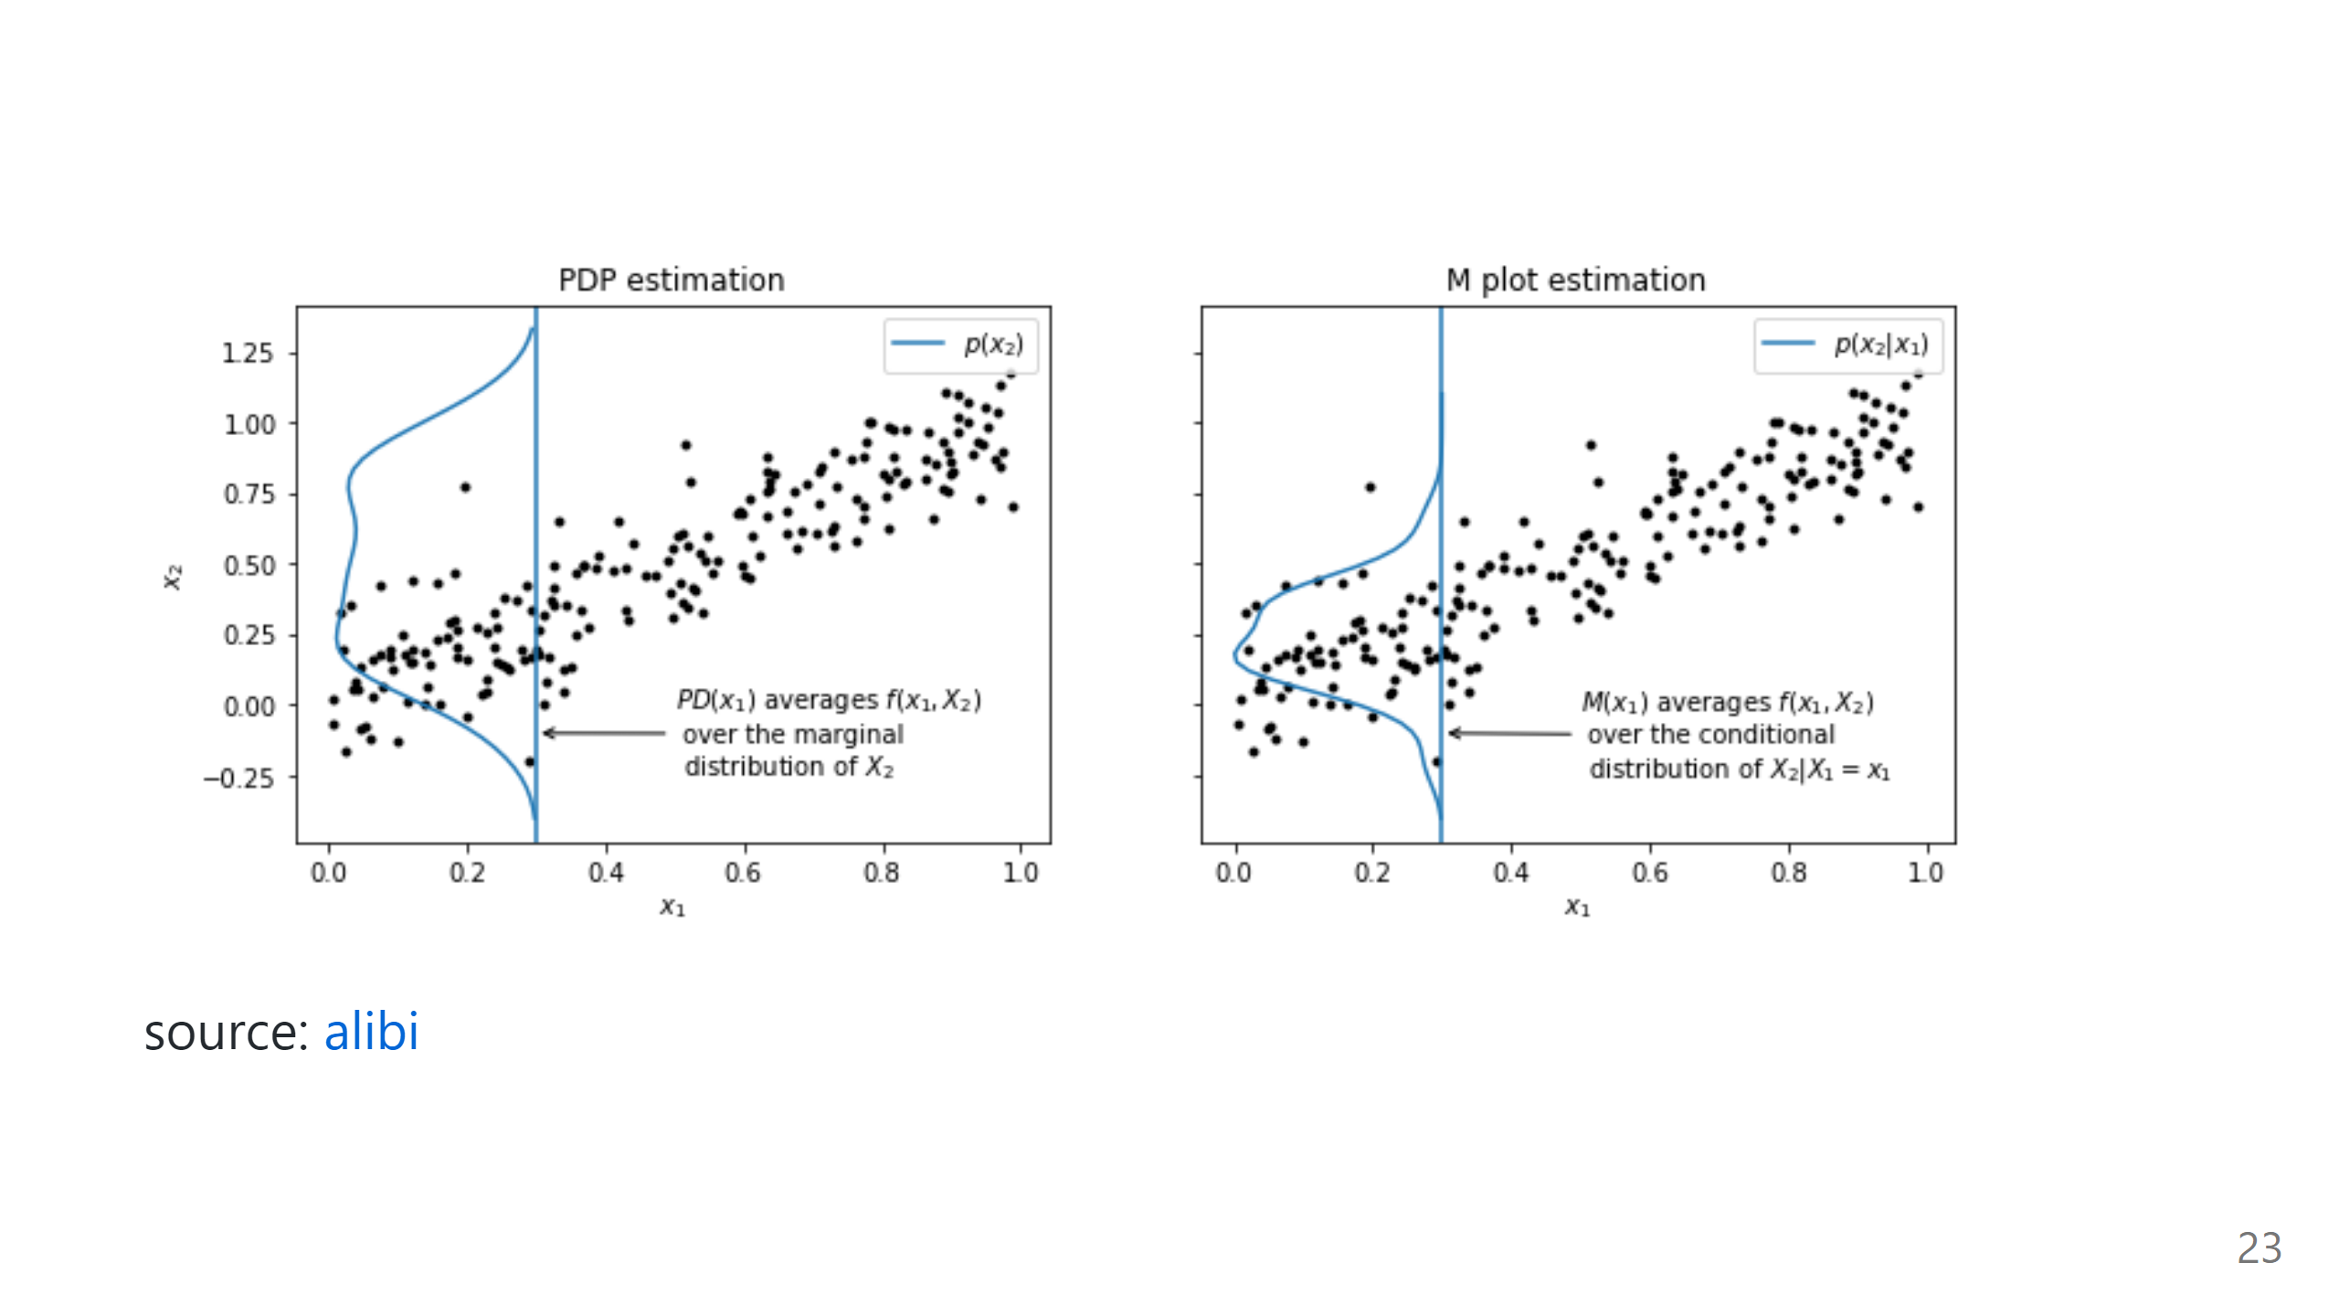

Slide 38
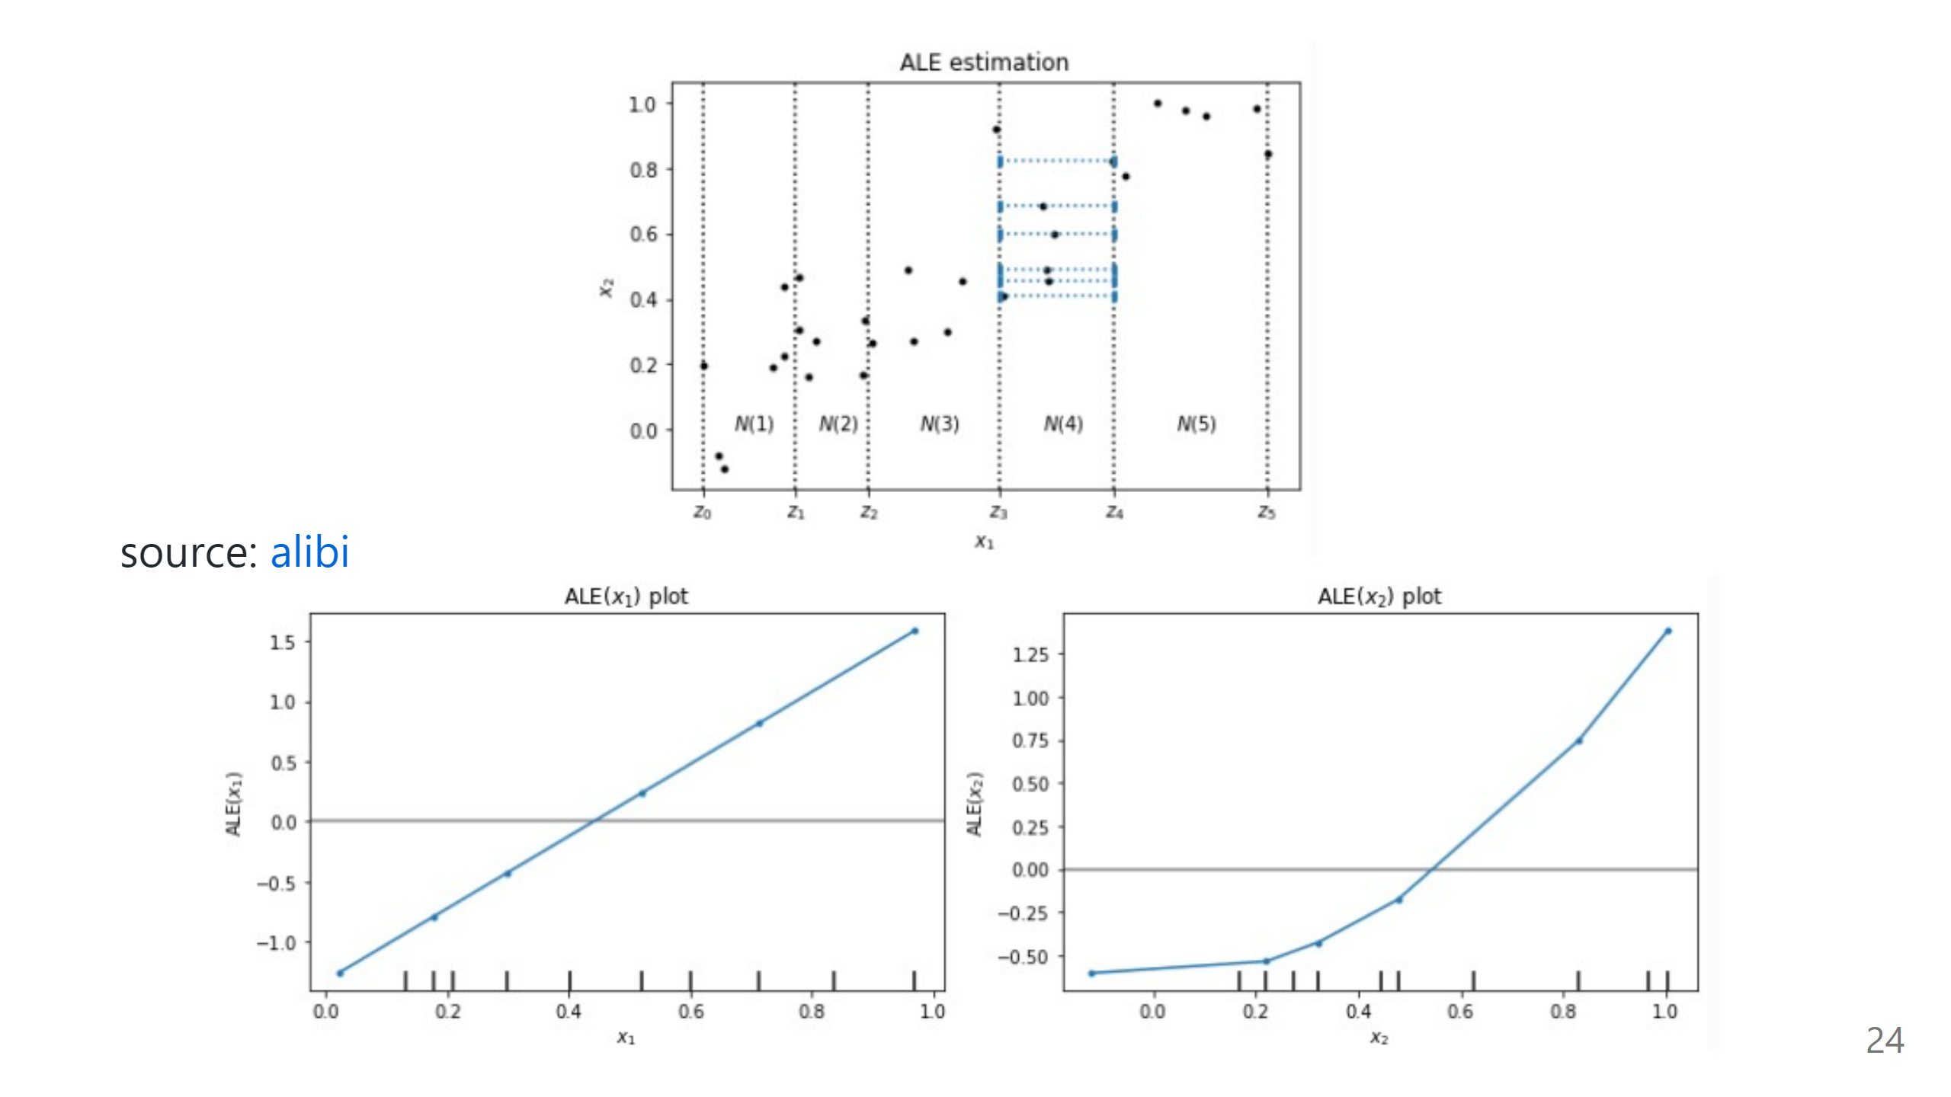

Slide 39
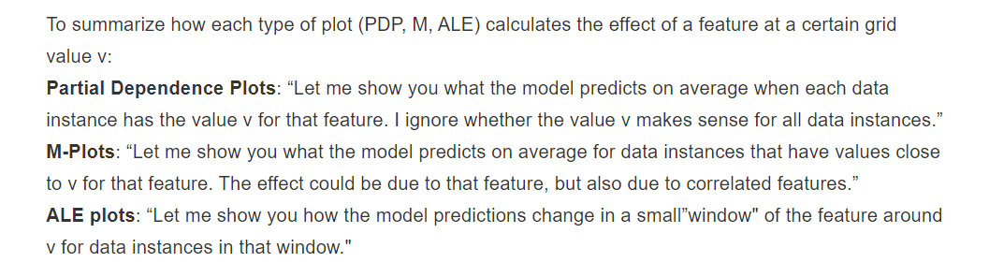

Slide 40
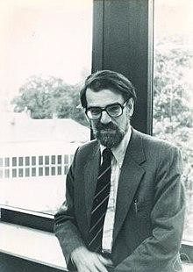
Shapley Value
Classic result in game theory on distributing the total gain from a cooperative game
Introduced by Lloyd Shapley in 1953¹, who later won the
Nobel Prize in Economics in the 2012
Popular tool in studying cost-sharing, market analytics, voting power, and most recently explaining ML models
Lloyd Shapley in 1980
¹ "A Value for n-person Games". Contributions to the Theory of Games 2.28 (1953): 307-317

Slide 41
Cooperative Game
Players {1, …, M} collaborating to generate some gain
Think: Employees in a company creating some proﬁt
Described by a set function v(S) specifying the gain for any subset S ⊆ {1, …, M}
Shapley values are a fair way to attribute the total gain to the players
Think: Bonus allocation to the employees
Shapley values are commensurate with the player’s contribution

Slide 42
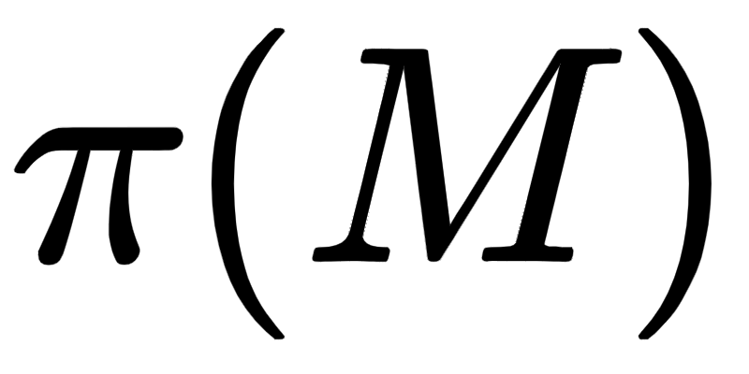
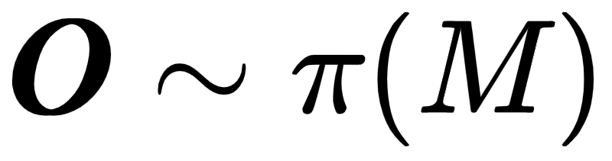
Shapley Value Algorithm [Conceptual]
Consider all possible permutations
In each permutation
of players (M! possibilities)
Add players to the coalition in that order
Note the marginal contribution of each player i to set of players before it in the permutation, i.e.,
The average marginal contribution across all permutations is the Shapley Value

Slide 43
Quiz
A company with two employees Alice and Bob
No employees, no proﬁt
Alice alone makes 20 units of proﬁt
Bob alone makes 10 units of proﬁt
Alice and Bob make 50 units of proﬁt
[v({}) = 0]
[v({Alice}) = 20]
[v({Bob}) = 10]
[v({Alice, Bob}) = 50]
What should the bonuses be?

Slide 44
Quiz
A company with two employees Alice and Bob
No employees, no profit
Alice alone makes 20 units of profit
Bob alone makes 10 units of profit
Alice and Bob make 50 units of profit
[v({}) = 0]
[v({Alice}) = 20]
[v({Bob}) = 10]
[v({Alice, Bob}) = 50]
What should the bonuses be?
Permutation | Marginal for Alice | Marginal for Bob
Alice, Bob | 20 | 30
Bob, Alice | 40 | 10
Shapley Value | 30 | 20

Slide 45
Axiomatic Justiﬁcation
Shapley values are unique under four simple axioms
Dummy: A player that doesn’t contribute to any subset of players must receive zero attribution
Eﬃciency: Attributions must add to the total gain
Symmetry: Symmetric players must receive equal attribution
Linearity: Attribution for the (weighted) sum of two games must be the same as the (weighted) sum of the attributions for each of the games

Slide 46
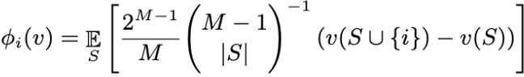
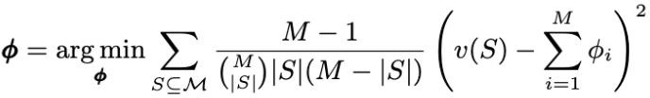
Computing Shapley Values
Exact computation
Permutations-based approach
(Complexity: O(M!))
Subsets-based approach
(Complexity: O(2^{M}))
KernelSHAP: Solve a weighted least squares problem (Complexity: O(2^{M}))

Slide 47

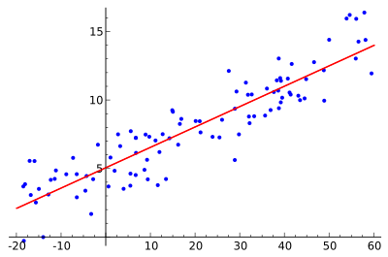
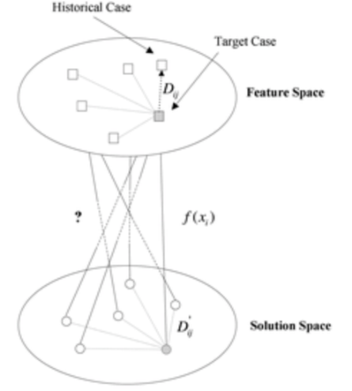
Taxonomy of Interpretable Models By Model Output
Rule Based Models
Relative Variable Importance
Case Based Models
A set of rules that describe how the prediction was made e.g., propositional rule learners, Bayesian rule lists, decision trees etc.
Linear models and related families of predictors that show relative importance and ordering of variables
Similarity function based models that use similar cases for prediction i.e., a prediction was made because this case looked like these k other cases

Slide 48
Taxonomy of Interpretable Models By Model Composition
First Order Models
Second Order Models
Models which have explanations built in as part of the model building process
Examples:
Decision Trees, GAMs, CENs etc.
Models that are built on top of black box models to provide explanations.
Local Models: LIME family of models, ASTRID, Random Forest Explainers,
Global/Student Models: Student models that train on model outputs of other models

Slide 49
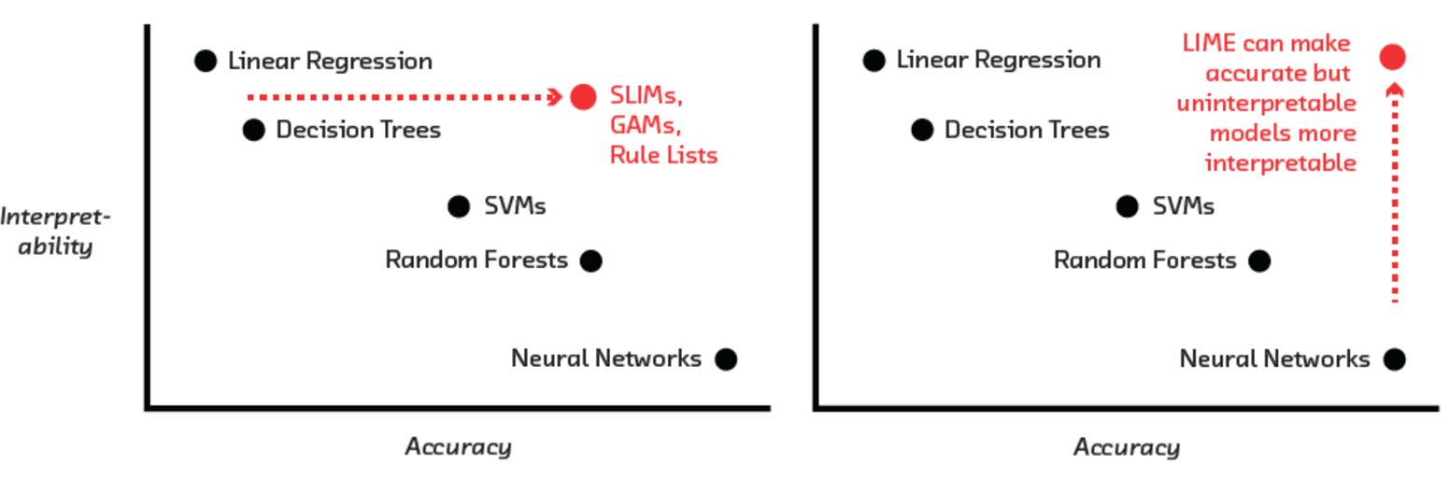

Accuracy vs. Interpretability

Slide 50
Feature Importance
Global feature importance values give an indication of the magnitude of a feature’s contribution to model predictions for all observations
Unlike regression parameters, they are often unsigned and typically not directly related to the numerical predictions of the model
Local feature importance describes how the combination of the learned model rules or parameters and an individual observation’s attributes affect a model’s prediction for that observation while taking nonlinearity and interactions into effect.

Slide 51
The Future: All AI Systems Explain Themselves
Given the proliferation of ML systems in healthcare and the potential impact on the lives of patients, the need for explanations will only increase
Only a matter of time before regulations comes to effect
Automation will bring greater scrutiny from practitioners
Lack of vigilance may lead to a ‘driverless car crash` moment in Ml in healthcare

